Slide 1
Introductory Lesson

Slide 2
Platform Access
Make sure you are using a recommended web browser:
GOOGLE CHROME
Always login through the Student Portal

Slide 3
From the Student Portal:
Click: Educational Resources (right side, gray box)

Slide 4
Click: Major Clarity

Slide 5
First Time Visiting the Site?
You will get a welcome pop-up.
It will walk you through a few very fast “tips” for the most important sections.

Slide 6
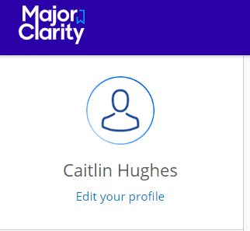
Verify your name is on the account.
Located on the top left.

Slide 7
Personality Assessment
In order to recommend career paths, you will first need to complete a quick five-minute personality assessment.

Slide 8
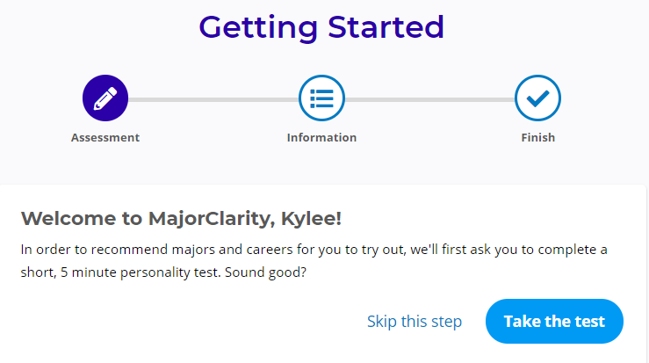
To begin the assessment, click the blue Take the test button.

Slide 9
Personality Assessment
For each statement, determine if you agree, disagree, or are unsure. Click the icon that best represents your response.

Slide 10
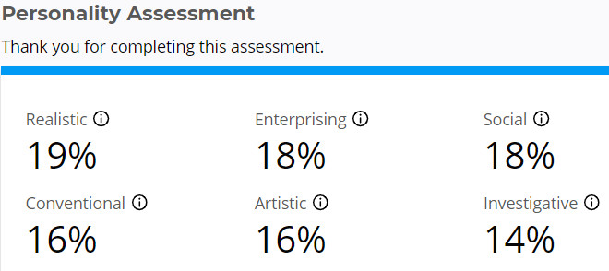
Once finished, view your results.
Add the results to the table in Section II of your worksheet.

Slide 11
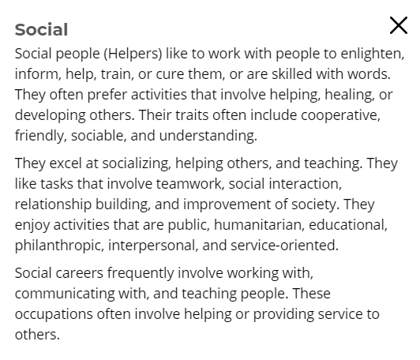
To learn more about a personality type, click the icon next to the category title.
Click Continue to proceed...

Slide 12
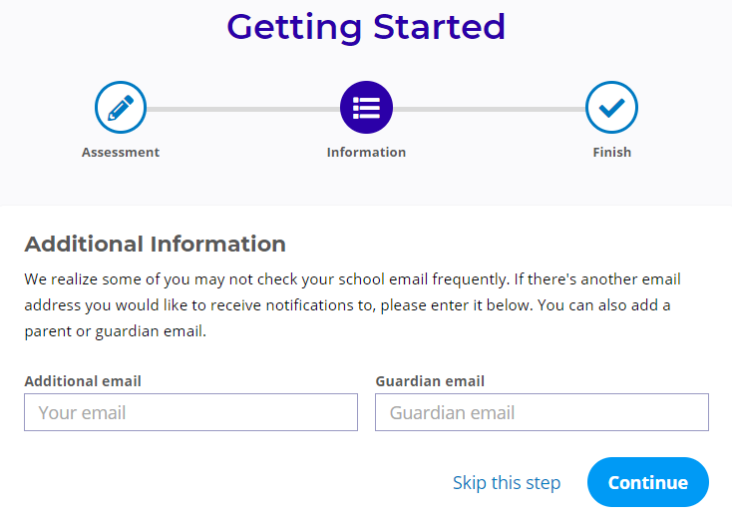
If this is your first time logging in, this will pop up: add additional email contacts to your MajorClarity account.
Click Skip this step

Slide 13
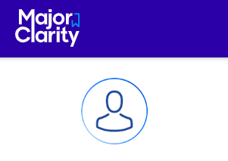
Before you begin exploring careers, update your profile.
Click the “Edit your profile” link beneath the user icon on the menu bar.

Slide 14
Profile Settings
Password Settings
Do NOT change these, you will continue to log in through the Student Portal/CLEVER.
Communication
Your parents' emails may already be listed, you will not be able to edit these. If they are incorrect, they must update them through Synergy or at the office. You may add your own personal email if you would like to. Keep in mind, this is NOT for logging in, only emails from MajorClarity.

Slide 15
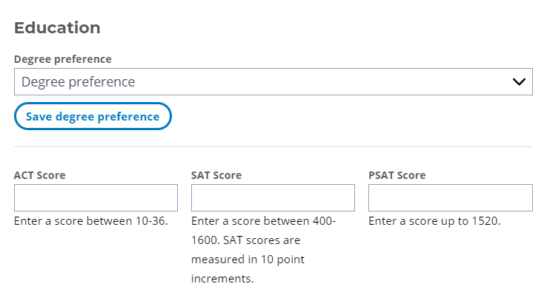
Education
Select a degree preference from the dropdown menu. (High School or Higher)
On another day, you may add ACT, SAT, & PSAT test scores that you have. This could take time to locate/log-in to your ACT/College Board accounts.

Slide 16
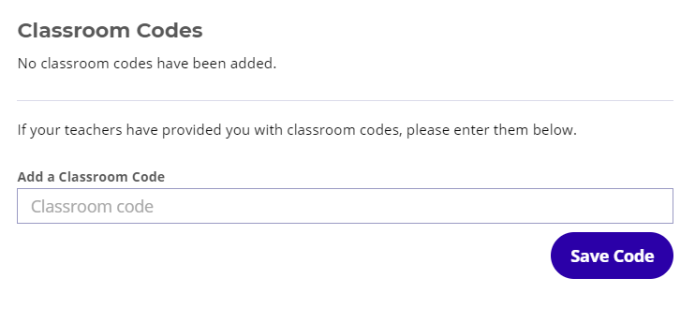
You will not need a classroom code today. Later, you may have a teacher request you enter their Classroom Code.
Remember this location for future requests from teachers.

Slide 17
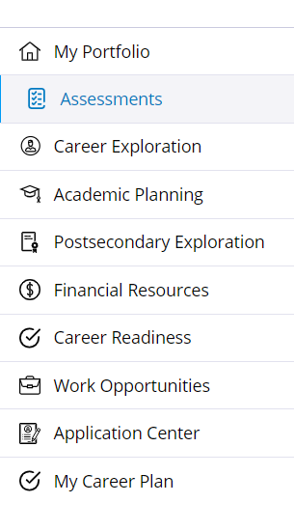
My Career Plan
This is where you document your Career Plans/ECAP.
This can be updated at any time.

Slide 18
Career Goals
Write a Brief Description in the empty box provided.
Create your electronic signature in the signature box using the mouse.

Slide 19
Education Goals
Diploma Type: PUSD only has ONE – choose “Standard”
Skip Diploma Recognition
Enter the Post-Secondary Goal
Enter either NONE or the Military Branch you are interested in.

Slide 20
Clubs and Activities
Enter the clubs and activities that you have been involved with during high school.
As you type a box appears below, click to choose the activity.
You can list multiple.

Slide 21
Test Scores and Workplace Readiness
Test Scores: this is another location to enter test scores, like ACT, SAT, or PSAT. (No need to do now).
Workplace Readiness: this is a place to keep track of CTE certificates and credentials.

Slide 22
Career Path “Fit Scores”
Click the Explore Careers tab on the left-side menu to view career paths.
Career paths in this section are ranked by compatibility.

Slide 23
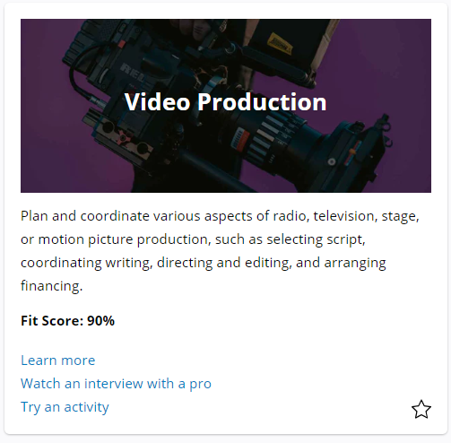
Career path panels are ordered from highest to lowest
“Fit Score”.

Slide 24
Your initial scores are determined by responses to questions on the Personality Assessment.
Scores change when you:
Test drive and rate your compatibility with a career path.
Retake the assessment.

Slide 25
Fill in the table in Section V on your worksheet.
Click on the career path panels to identify corresponding career clusters.

Slide 26
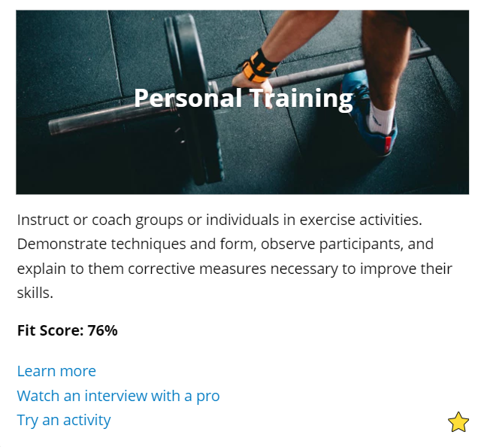
List of Favorites
Clicking the star icon in the bottom corner of a career path panel will shade the star yellow; this indicates that the item has been added to your list of Favorites.
Note: It doesn’t have to be your highest Fit Score!

Slide 27
Clicking a Career path panel allows you to learn more about the path, watch an interview, try an activity and learn which occupations fall under that path.

Slide 28
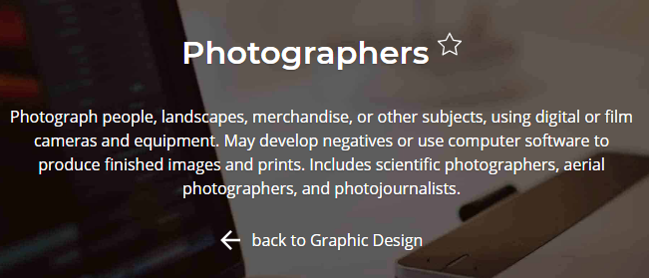
List of Favorites
You can also save an occupation to your Favorites by clicking the star beside its title on the occupation overview page.

Slide 29
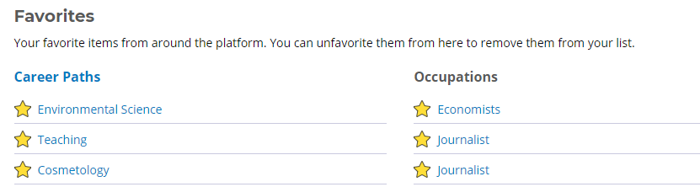
List of Favorites
Navigate to the My Portfolio tab on the left-side menu to review saved items.

Slide 30
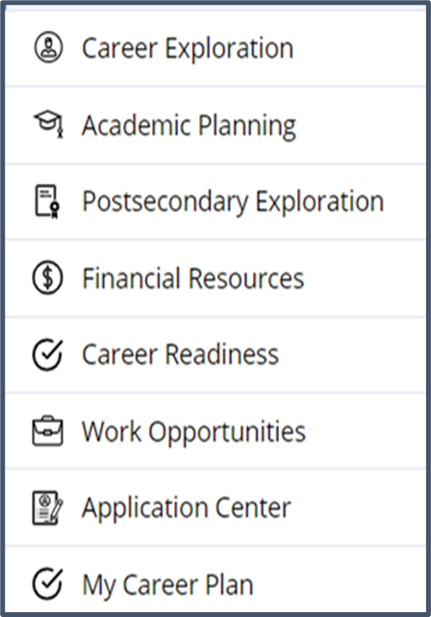
Other Tabs:
Academic Planning – this is where we will track your coursework!
Postsecondary Explorations – this is a college search.
Financial Resources – this is a scholarship search.
Application Center – this is a place to keep track of college applications.

Slide 31
Enjoy exploring on your own!
Next year we will continue to add to your profile, and this will serve as the main source to document your ECAP!

